Slide 1
Last Lecture: Name Spaces
Name | Type | Addr | Len | SC | …
y | int | 8 | 4 | local
x | char | 12 | 2 | static
z | double | 0 | 8 | local
h(y)
z |  |  |  |  |  |  |  | y |  |  |  | x
0 | 1 | 2 | 3 | 4 | 5 | 6 | 7 | 8 | 9 | 10 | 11 | 12 | 13
Storage map implied by the symbol table
Usually there are more than one name spaces.
A compiler has one or more symbol tables
Symbol table if there is a single name space: using a hash table

Slide 2
Last Lecture: Name Spaces
Many programing languages use lexical scoping: a name refers to the definition that is lexically closest to its use - that is, the definition in the closest surrounding scope.
Lexically scoped symbol tables
Create a new table for each scope
Chain them together for lookup
•
x
x
•
z
b
b
...
•
p
h (z)
q
r
•
y
w
b
x
•
v
a
h(y)
•
v
a
...
y
b
c
Level | Procedure
3 | r
2 | q
1 | p
x
w
•
c
z

Slide 3
Where Do All These Variables Go?
Automatic & Local
Automatic ⇒ lifetime matches procedure’s lifetime
Static & Global
Lifetime longer than procedure’s lifetime
Name | Type | Addr | Len | SC | …
y | int | 8 | 4 | local
x | char | 12 | 2 | static
z | double | 0 | 8 | local
z |  |  |  |  |  |  |  | y |  |  |  | x
0 | 1 | 2 | 3 | 4 | 5 | 6 | 7 | 8 | 9 | 10 | 11 | 12 | 13
Storage map implied by the symbol table

Slide 4
Chapter 6 The Procedure Abstraction

Slide 5
Conceptual Overview
Procedures provide the fundamental abstractions that make programming practical & large software systems possible
Information hiding
Distinct and separable name spaces
Uniform interfaces
Hardware does little to support these abstractions
Part of the compiler’s job is to implement them
Compiler makes good on lies that we tell programmers
Part of the compiler’s job is to make it efficient
Role of code optimization

Slide 6
The Procedure & Its Three Abstractions
The compiler produces code for each procedure
The individual code bodies must fit together to form a working program
Compiled Code
Compiled Code
Compiled Code
Compiled Code
Compiled Code
Compiled Code
Compiled Code
Compiled Code
Compiled Code
Compiled Code
Procedure
Compiled Code
Compiled Code
Compiled Code

Slide 7
The Procedure & Its Three Abstractions
Each procedure inherits a set of names
Variables, values, procedures, objects, locations, …
Clean slate for new names, “scoping” can hide other names
Naming Environment
Compiled Code
Procedure
“Naming” includes the ability to find and access objects in memory

Slide 8
The Procedure & Its Three Abstractions
Control History
Each procedure inherits a control history
Chain of calls that led to its invocation
Mechanism to return control to caller
Naming Environment
Compiled Code
Procedure
Some notion of parameterization
(ties back to naming)

Slide 9
The Procedure & Its Three Abstractions
Control History
Each procedure has access to external interfaces
Access by name, with parameters (may include dynamic link & load)
Protection for both sides of the interface
Naming Environment
External Interface: other procedures, system services
Compiled Code
APIs
Procedure

Slide 10
The Procedure: Three Abstractions
External Interface
Access is by procedure name & parameters
Clear protection for both caller & callee
Invoked procedure can ignore calling context
Control Abstraction
Well defined entries & exits
Mechanism to return control to caller
Some notion of parameterization (usually)
Clean Name Space
Clean slate for writing locally visible names
Local names may obscure identical, non-local names
Local names cannot be seen outside
Procedures permit a critical separation of concerns

Slide 11
The Procedure as an External Interface
Naming plays a critical role in our ability to use procedure calls as a general interface
OS needs a way to start the program’s execution
Programmer needs a way to indicate where it begins
The procedure “main” in most languages
When user invokes “grep” at a command line
OS finds the executable
OS creates a process and arranges for it to run “grep”
Conceptually, it does a fork() and an exec() of the executable “grep”
“grep” is code from the compiler, linked with run-time system
Starts the run-time environment & calls “main”
After main, it shuts down run-time environment & returns
When “grep” needs system services
It makes a system call, such as fopen()
UNIX/Linux specific discussion

Slide 12
The Procedure as a Control Abstraction
Procedures have well-defined control-flow
The Algol-60 procedure call
Invoked at a call site, with some set of actual parameters
Control returns to call site, immediately after invocation
Most languages allow recursion
int p(a,b,c)
int a, b, c;
{
int d;
d = q(c,b);
...
}
int q(x,y)
int x,y;
{
if ( … )
x = q(x-1,y);
return x + y;
}
…
s = p(10,t,u);
…

Slide 13
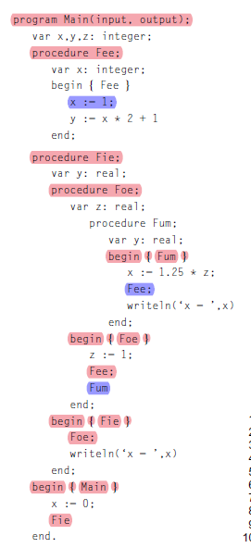
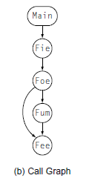
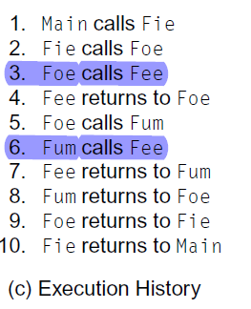
The Procedure as a Control Abstraction
Activation
A call to a procedure activates it; thus, we call an instance of its execution an activation.

Slide 14
The Procedure as a Control Abstraction
When p calls q, the address in p where execution should continue after p’s return is called its return address.
Implementing procedures with this behavior
Requires code to save and restore a “return address”
Must map actual parameters to formal parameters (c→x, b→y)
Must create storage for local variables (&, maybe, parameters)
p needs space for d (&, maybe, a, b, & c)
where does this space go in recursive invocations?
Compiler emits code that causes all this to happen at run time
int p(a,b,c)
int a, b, c;
{
int d;
d = q(c,b);
...
}
int q(x,y)
int x,y;
{
if ( … )
x = q(x-1,y);
return x + y;
}
…
s = p(10,t,u);
…

Slide 15
The Procedure as a Control Abstraction
Implementing procedures with this behavior
Must preserve p’s state while q executes
Strategy: Create unique location for each procedure activation
In simple situations, can use a “stack” of memory blocks to hold local storage and return addresses (closures ⇒ heap allocate)
The stack mechanism handles recursion as well. The call mechanism, in effect, unrolls the cyclic path through the call graph and creates a distinct activation for each call to a procedure.
Compiler emits code that causes all this to happen at run time
int p(a,b,c)
int a, b, c;
{
int d;
d = q(c,b);
...
}
int q(x,y)
int x,y;
{
if ( … )
x = q(x-1,y);
return x + y;
}
…
s = p(10,t,u);
…

Slide 16
The Procedure as a Control Abstraction
In essence, the procedure linkage wraps around the unique
code of each procedure to give it a uniform interface
Similar to building a brick wall rather than a rock wall
Compiled Code
Compiled Code
Compiled Code
Compiled Code
Compiled Code
Compiled Code
Compiled Code
Compiled Code
Compiled Code
Compiled Code
Compiled Code
Compiled Code
Compiled Code
Compiled Code
Compiled Code
Compiled Code
Compiled Code
Compiled Code
Compiled Code
Compiled Code
Compiled Code
Compiled Code
Compiled Code
Compiled Code

Slide 17
The Procedure as a Name Space
The Java twist: allow fully qualified names to reach around scope rules
Each procedure creates its own name space
Any name (almost) can be declared locally
Local names obscure identical non-local names
Local names cannot be seen outside the procedure
Nested procedures are “inside” by definition
We call this set of rules & conventions “lexical scoping”
Examples
C has global, static, local, and block scopes (Fortran-like)
Blocks can be nested, procedures cannot
Scheme has global, procedure-wide, and nested scopes (let)
Procedure scope (typically) contains formal parameters

Slide 18
The Procedure as a Name Space
How does the compiler represent a specific instance of x ?
Name is translated into a static coordinate
< level,offset > pair
“level” is lexical nesting level of the procedure
“offset” is unique within that scope
Subsequent code will use the static coordinate to generate addresses and references
“level” is a function of the table in which x is found
Stored in the entry for each x
“offset” must be assigned and stored in the symbol table
Assigned at compile time
Known at compile time
Used to generate code that executes at run-time

Slide 19
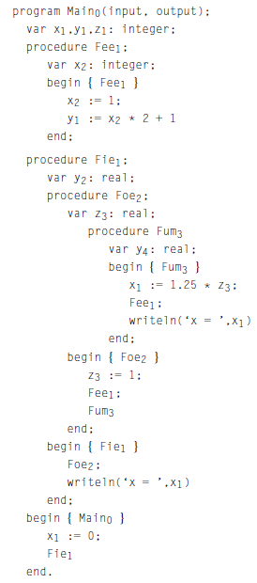
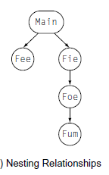
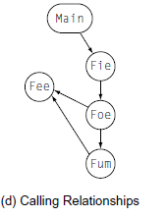
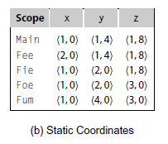
The Procedure as a Name Space

Slide 20
Runtime Structures to Support Algol-like Languages
To implement the twin abstractions of procedure calls and scoped name spaces, the translation must establish a set of runtime structures.
The key data structure is the Activation Record (AR)
Activation record is a region of storage set aside to hold control information and data storage associated with a single instance of a single procedure
The entire AR is addressed through an activation record pointer (ARP), with various fields in the AR found at positive and negative offsets from the ARP.
In principle, every procedure call gives rise to a new AR. Thus, recursion gives rise to multiple ARs, each of which holds the local state for a different invocation of the recursive procedure.

Slide 21
Activation Record Basics
Space for local values & variables (including spills)
local
variables
To restore caller’s AR on a
return
caller’s ARP
Help with non-local access
ARP
addressability
Address to resume caller
return address
If function, space for return value
return value
register
save area
Saved register contents
parameters
Space for parameters to the current routine
One AR for each invocation of a procedure
ARP ≈ Activation Record Pointer

Slide 22
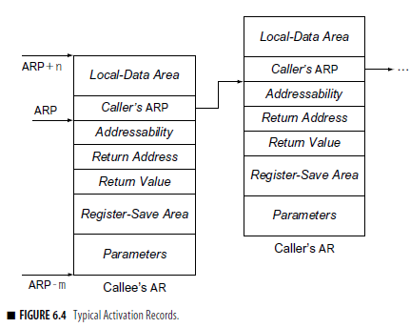
Activation Record Basics
The ARP always points to a designated location in the AR.
The central part of the AR has a static layout; all the fields have known fixed lengths. This ensures that the compiled code can access those items at fixed offsets from the ARP.
The ends of the AR are reserved for storage areas whose sizes may change from one invocation to another; typically one holds parameter storage while the other holds local data.

Slide 23
Activation Record Details
C
o
d
e
S G
t l
a & o
t b
i a
c l
S
t
a
c
k
H
e
a
p
Yes! That stack
Where do activation records live?
If lifetime of AR matches lifetime of invocation, AND
If code normally executes a “return”
Keep ARs on a stack
If a procedure makes no calls
AR can be allocated statically
If a procedure can outlive its caller, OR
If it can return an object that can reference its execution state
ARs must be kept in the heap
Efficiency prefers static, stack, then heap

Slide 24
Activation Record Details
How does the compiler find the variables?
They are at known offsets from the AR pointer
The static coordinate leads to a “loadAI” operation
Level specifies an ARP, offset is the constant
Most compilers dedicate a hardware register to hold the ARP of the current procedure. In ILOC, we refer to this dedicated register as rarp.

Slide 25
So far, we have learned
Represent variables by their static coordinates, <level,offset>
Must map, at runtime, level into a data-area base address
Must emit, at compile time, code to perform that mapping
local
variables
ARP
caller’s ARP
addressability
return address
return value
register
save area
parameters

Slide 26
Establishing Addressability
Compiler must compute base addresses for each kind of data area
Local variables
Convert to static data coordinate and use ARP + offset
Local variables of other procedures
Convert to static coordinates
Find appropriate ARP
Use that ARP + offset
Global & static variables
Construct a label by mangling names (i.e., &_fee)
Use static coordinates
Must find the right AR
Need links to nameable ARs
Use name mangling & asm labels
The “free variables” mentioned earlier; Lexical scoping has replaced deep binding for these variables with efficient lookups.

Slide 27
Finding the “Right” ARP
procedure main {
procedure p1 { … }
procedure p2 {
procedure q1 { … }
procedure q2 {
procedure r1 { … }
procedure r2 {
call p1; … // call up from level 3 to level 1
}
call r2; // call down from level 2 to level 3
}
call q2; // call down from level 1 to level 2
}
call p2; // call down from level 0 to level 1
}
Main
0 to 1
p2
1 to 2
q2
2 to 3
r2
3 to 1
p1
Call History
Surrounding lexical scope may not be the caller

Slide 28
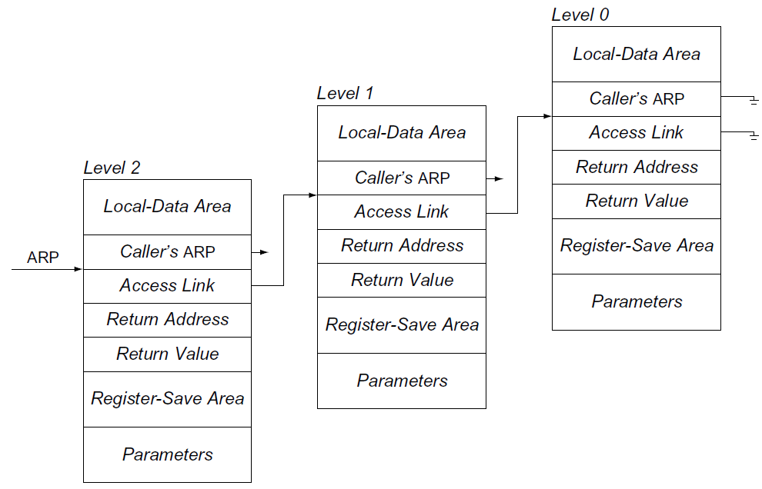
Establishing Addressability- Using Access Links
Using Access Links to Find an ARP for a Non-Local Variable
Each AR has a pointer to AR of lexical ancestor
Lexical ancestor need not be the caller
Reference to <p,16> runs up access link chain to p
Cost of access is proportional to lexical distance
Some setup cost
on each call

Slide 29
Establishing Addressibility - Using Access Links
To maintain access links, the compiler must add code to each procedure call that finds the appropriate ARP and stores it as the callee’s access link.
For a caller at level m and a callee at level n
n = m +1 : the callee is nested inside the caller, the callee can use the caller’s arp as its access link.
n =m: the callee’s access link is the same as the caller’s access link.
n < m, the callee’s access link is the level (n -1) access link for the caller

Slide 30
Establishing Addressability - Using Access Links
To maintain access links, the compiler must add code to each procedure call that finds the appropriate arp and stores it as the callee’s access link.
For a caller at level m and a callee at level n
n = m +1 : the callee is nested inside the caller, the callee can use the caller’s arp as its access link.
n =m: the callee’s access link is the same as the caller’s access link.
n < m, the callee’s access link is the level (n -1) access link for the caller
SC | Generated Code
<2,8> | loadAI r₀,8 | ⇒ r₁₀
<1,12> | loadAI r₀,-4 | ⇒ r₁
 | loadAI r₁,12 | ⇒ r₁₀
<0,16> | loadAI r₀,-4 | ⇒ r₁
 | loadAI r₁,-4 | ⇒ r₁
 | loadAI r₁,16 | ⇒ r₁₀
Assume
Current lexical level is 2
Access link is at ARP – 4
ARP is in r₀

Slide 31
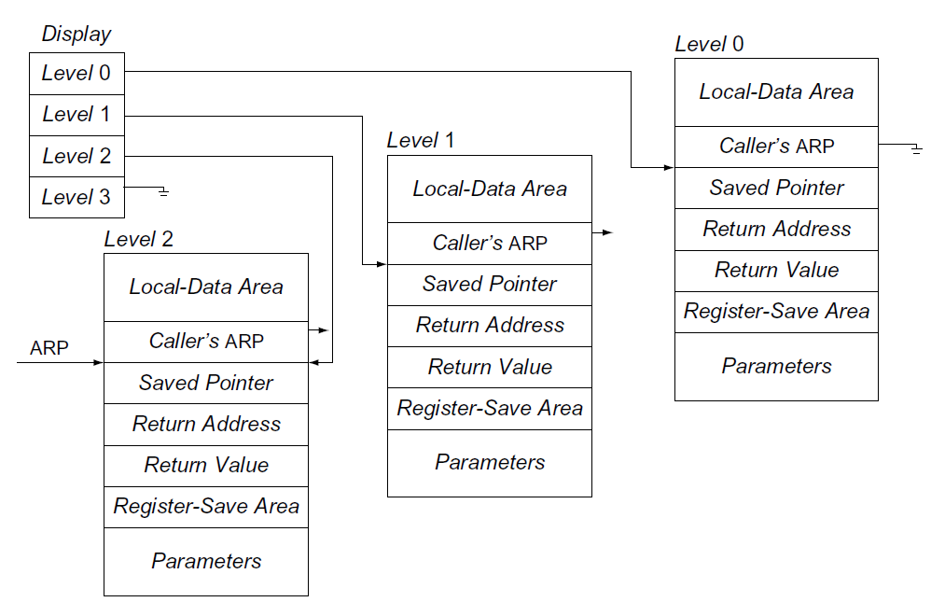
Establishing Addressability – Using a Display
Using a Display to Find an ARP for a Non-Local Variable
Global array of pointer to nameable ARs
Needed ARP is an array access away
Reference to <p,16> looks up p’s ARP in display & adds 16
Cost of access is constant (ARP + offset)
Some setup cost
on each call

Slide 32
Establishing Addressability - Using a Display
Using a Display
Access & maintenance costs are fixed
Address of display may consume a register
Assume
Current lexical level is 2
Display is at label _disp
SC | Generated Code
<2,8> | loadAI r₀,8 | ⇒ r₁₀
<1,12> | loadI _disp | ⇒ r₁
 | loadAI r₁,4 | ⇒ r₁
 | loadAI r₁,12 | ⇒ r₁₀
<0,16> | loadI _disp | ⇒ r₁
 | loadAI r₁,0 | ⇒ r₁
 | loadAI r₁,16 | ⇒ r₁₀
Desired AR is at _disp + 4 x level

Slide 33
Establishing Addressability
Access Links Versus Display
Each adds some overhead to each call
Access links costs vary with level of reference
Overhead only incurred on references & calls
If ARs outlive the procedure, access links still work
Display costs are fixed for all references
References & calls must load display address
Typically, this requires a register (rematerialization)
Your mileage will vary
Depends on ratio of non-local accesses to calls
Extra register can make a difference in overall speed
For either scheme to work, the compiler must
insert code into each procedure call & return

Slide 34
Creating and Destroying Activation Records
All three parts of the procedure abstraction leave state
in the activation record
How are ARs created and destroyed?
Procedure call must allocate & initialize (preserve caller’s world)
Return must dismantle environment (and restore caller’s world)
Caller & callee must collaborate on the problem
Caller alone knows some of the necessary state
Return address, parameter values, access to other scopes
Callee alone knows the rest
Size of local data area (with spills), registers it will use
Their collaboration takes the form of a linkage convention
Assume, for the moment, an Algol-60 environment where the activation information is dead on the return.
Notes:
Three abstractions are control abstraction, name space, external interfaces

